Slide 1
Goals for the day
Why/When isn’t OLS enough?
General Linear Model (GLM)
MLE

Slide 2
Why/when isn’t OLS enough?

Slide 3
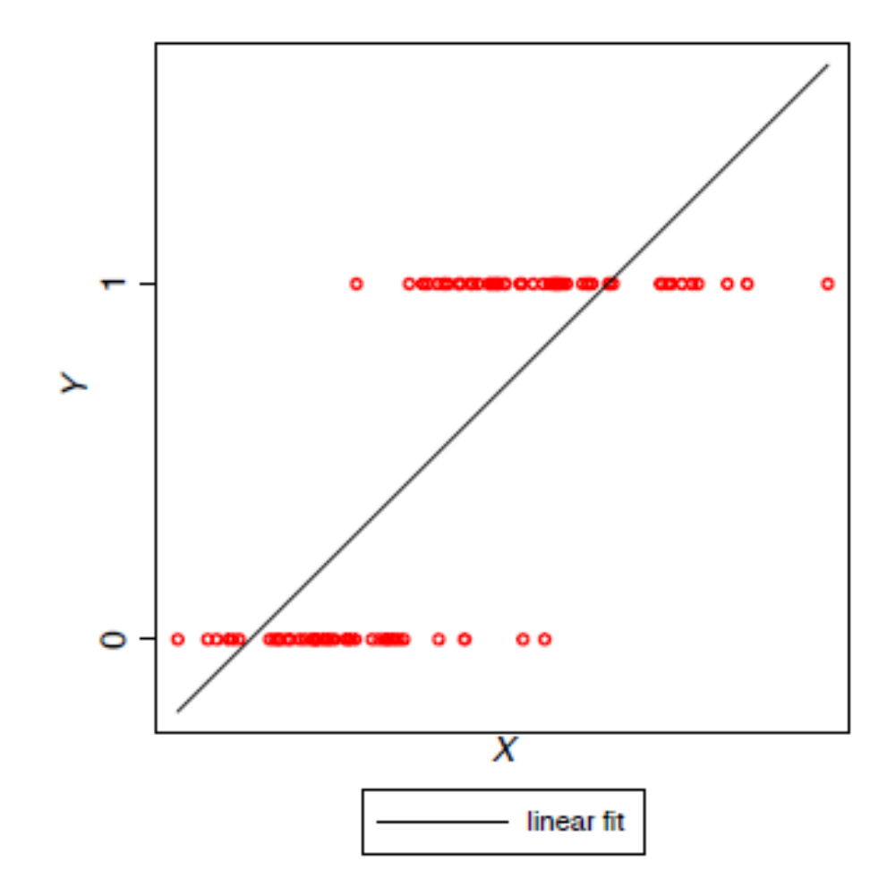
Consider a Dichotomous DV
Linearity (no)
Full Rank/No Perfect Multicollinearity
Zero Conditional Mean: ε_{i}|X = 0 (no)
Spherical Errors:
  Homoscedasticity – (no; deviations from linear prediction not constant)
  No Autocorrelation
Normality in Error Distribution
  Zero Conditional Mean + Homoskedasticity (no)
Nonstochastic Regressors

Slide 4
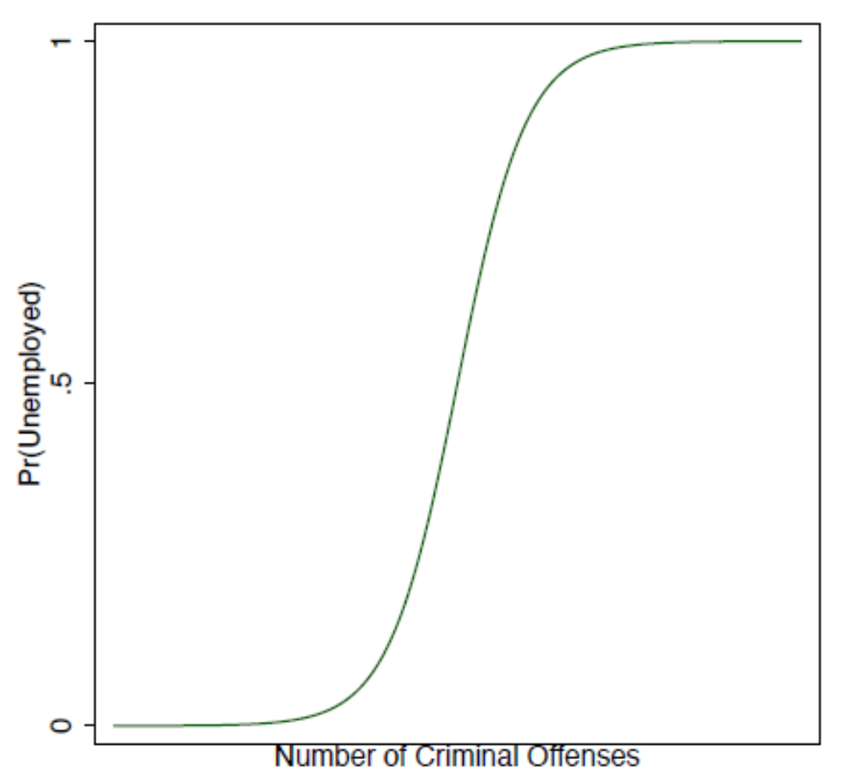
Why not just use OLS (Linear Probability Model)?
Nonsensical predictions
  i.e. probabilities < 0 and/or >1
Linearity improper functional form
  By imposing linearity, OLS assumes a constant effect of X on Y
  Imagine a LPM predicts a 0.4 unit increase in prob of being unemployed for every criminal offense
    Implies someone w/3 offenses has a probability 1.2 higher than someone w/0
      Impossible
      Effects likely nonlinear (sigmoidal?)

Slide 5
General Linear Model (GLM)
In 1972, Nelder and Wedderburn proposed that many statistical share a common core
Specifically, these models
  Contain a single dependent variable
  Assume a distribution that belongs to the exponential family
Proposed GLM as a unifying statistical framework
Since many of the MLE applications that we consider are members of the GLM, it is useful to discuss this statistical framework

Slide 6
General Intuition
If we (think we) know the basic data generating process (DGP) (i.e. if we can assume a distribution with known properties), we can distinguish what kind of outcomes are likely to occur
If we have a guess about the basic DGP and know what outcomes have occurred, we can work backwards and update our beliefs about what DGP is most likely to have generated those outcomes
What are the right distributional assumptions?

Slide 7
The Exponential Family
The exponential family captures many distributions used in statistics
This includes both probability mass functions (discrete random variables) and probability density functions (continuous random variables)
Distributions belonging to the exponential family include:
  Normal
  Binomial
  Exponential
  Gamma
  Poisson

Slide 8
5 GLM Components
A random component for the response variable, y, whose distribution belongs to the exponential family.
A linear function of a set of covariates that is known as the linear predictor and is given by η = Xβ.
A known, monotonic, and differentiable link function, g, such that
  μ = E[y]
  = g⁻¹(η) … where g⁻¹ is the inverse of the link function.
A variance function describing the dispersion in y.
Optional: One or more offsets that can build parameter constraints into the model

Slide 9
GLM Assumptions
Model correctly specified
  Right predictors, no endogeneity
Link function correctly specified
Variance function correctly specified

Slide 10
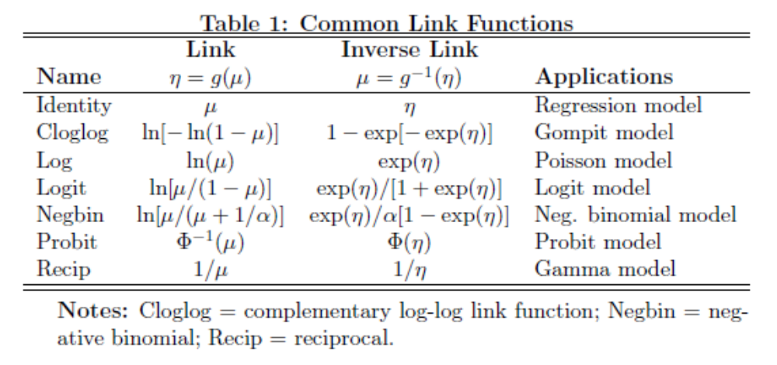

Slide 11
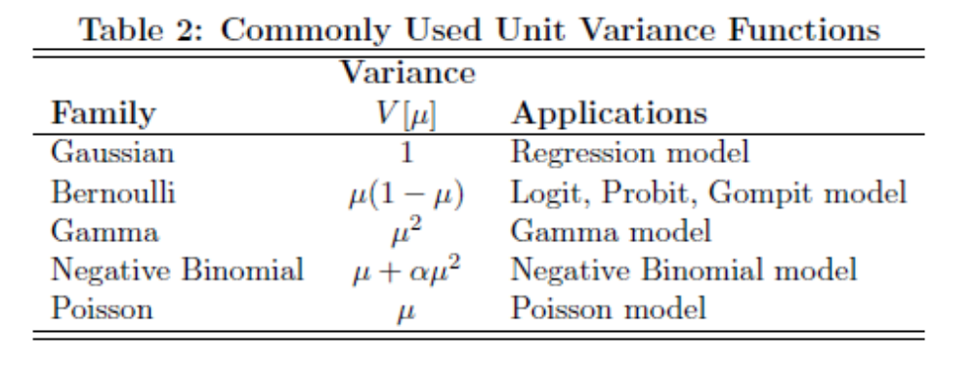

Slide 12
Maximum Likelihood Estimation
Ronald Fisher (1930’s)
A maximum likelihood estimate is that value of the population parameter (theta) that makes the observed data most probable.
GLM family of estimators that are all estimated in the same basic way

Slide 13
Choosing the distribution
MLE requires a distributional assumption.
“Canned” routines pick this distribution for you.
However, you need to make sure that the distribution makes sense for the problem at hand.
That is, do the properties of the distribution fit the known characteristics of the phenomenon that is being modeled?

Slide 14
Assumptions of MLE
The population is characterized by a probability mass or density function that is known, up to the parameters that have to be estimated.
The sample consists of n conditionally independent draws from the probability mass or density function.
These assumptions imply that the observations are i.i.d.—independently and identically distributed.

Slide 15
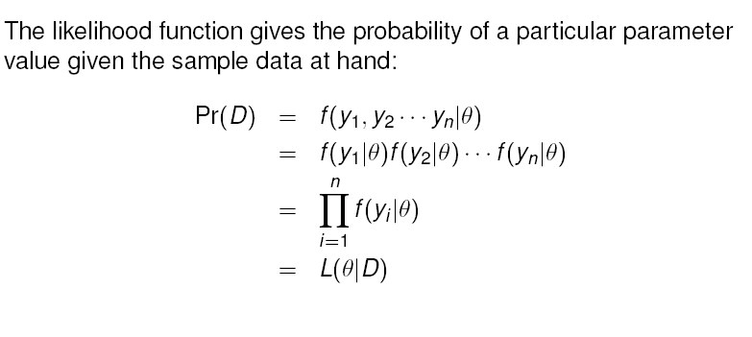
The Intuition in Math
Y is the data, theta is the guessed parameters
Is essentially summing the residuals

Slide 16
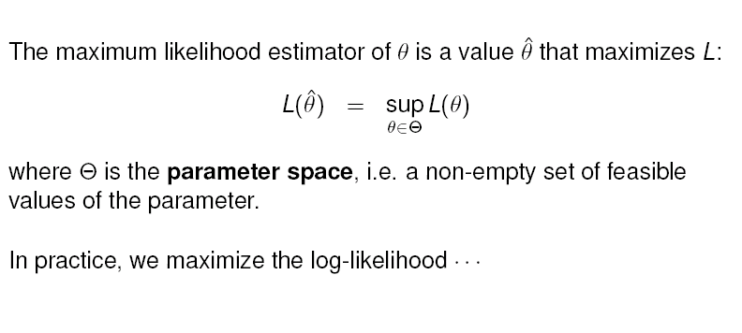
The Intuition in Math

Slide 17
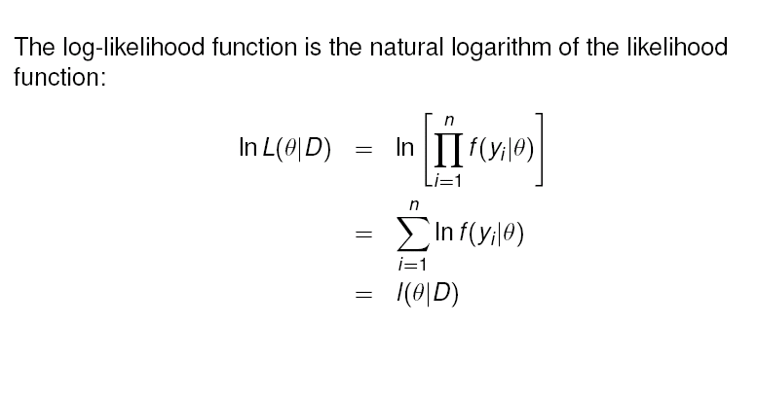
The Intuition (in Math)
(calculus is easier with logs and arithmetic than with products)

Slide 18
Solving the model
Find where dl/dθ=0
Find where d²l/(dθ dθ)<0 (ensure is not a minimum or a flat spot
Then calculate the standard errors of the model and of specific parameters using the inverted hessian matrix…

Slide 19
Why don’t actually do any of this…
The previous math (or the math in Steenbergen) is often close to impossible, especially in models that are non-linear in the parameters
Instead use Numerical optimization techniques
  Numerical optimization is a process whereby a computer algorithm continuously refines an initial numerical guess of the parameters, until the maximum of an objective function has been found.

Slide 20
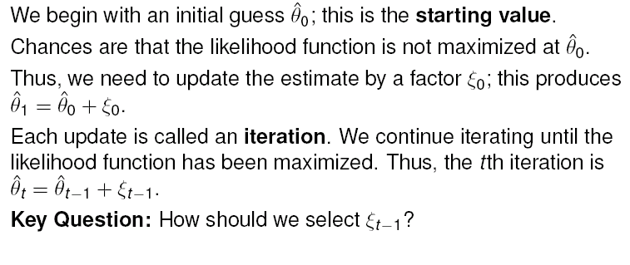
Estimating θ (What the Computer Does)

Slide 21
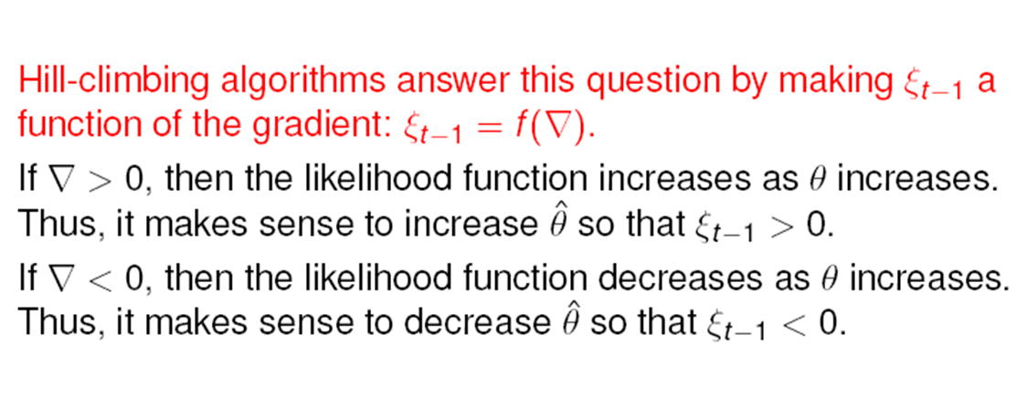
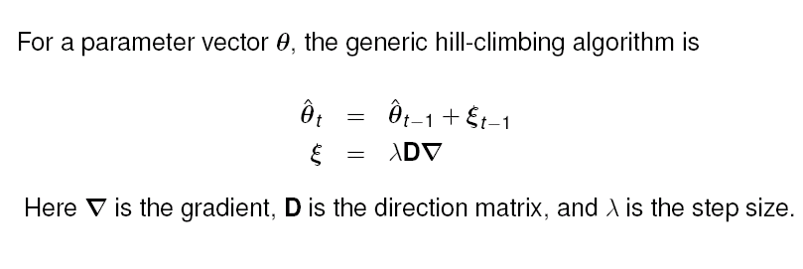
Basic Intuition (What the Computer Does)

Slide 22
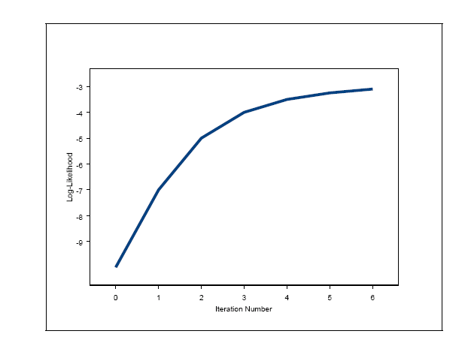
Ideal Convergence Path

Slide 23
Will not always converge
Small n.
Complex/irregular log-likelihood function.
Estimation at the boundary of parameter space.
Large ratio in the variances of variables.
Inappropriate model.
Data cleaning problems.

Slide 24
Nice principles of MLE
Consistency
  the probability that the estimator differs from the population parameter(s) by some arbitrarily small amount will tend to zero as the sample size goes to infinity.
Efficiency
  MLE will have the smallest possible variance IF estimator is unbiased b/c all assumptions are kept
  Of course, it is always biased, especially in small samples

Slide 25
What are we going to do?
Learn about (some of) the different distributions
  Dichotomous outcomes
  Ordered outcomes
  Categorical outcomes
  Counts
  Length of time
  Data with ceilings and floors
  Data that add up to something (are not independent)

